Slide 1
Course Name :
Software Engineering
T V Rao
Prescriptive Process Flows

Slide 2
A process defines who does what, when and how in order to achieve a preset goal
- Jacobson et al [99]

Slide 3
Prescriptive and Agile Processes
Prescriptive processes are processes where all of the process activities are planned in advance and progress is measured against this plan.
In agile processes, planning is incremental and it is easier to change the process to reflect changing customer requirements.
In practice, most practical processes may include elements of both plan-driven and agile approaches.
There are NO right or wrong software processes.

Slide 4
Prescriptive Process Model
Defines a distinct set of activities, actions, tasks, milestones, and work products that are required to engineer high-quality software
The activities may be linear, incremental, or evolutionary

Slide 5
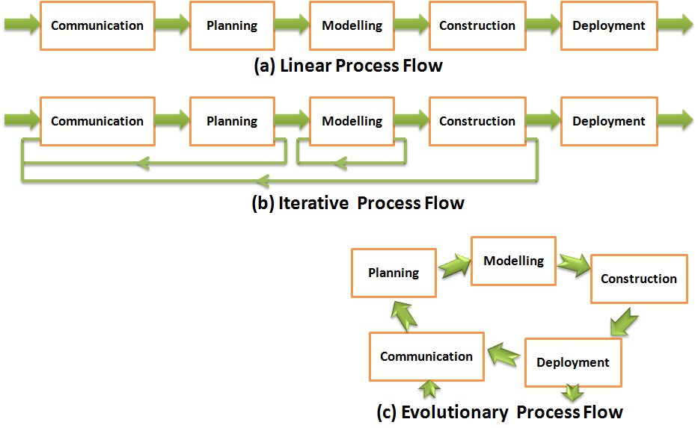
Process Models
An important
variation among
process models
comes from flow
of activities

Slide 6
Waterfall Model
(Diagram)
Project Initiation
Requirement Gatherings
Communication:
Estimation
Scheduling
Tracking
Planning:
Analysis
Design
Modelling:
Code
Test
Construction:
Delivery
Support
Feedback
Deployment:

Slide 7
Critique of the waterfall model
The model implies that you should attempt to complete a given stage before moving on to the next stage
  Does not account for the fact that requirements constantly change.
  It also means that customers can not use anything until the entire system is complete.
The model makes no allowances for prototyping.
Assumes understanding of problem and full requirements early on
It implies that you can get the requirements right by simply writing them down and reviewing them.
Inflexible partitioning of the project into distinct stages makes it difficult to respond to changing customer requirements.

Slide 8
Critique of Waterfall Model continued
Follows systematic approach to development
The model implies that once the product is finished, everything else is maintenance.
Assumes patience from customer
Surprises at the end are very expensive
Some teams sit idle for other teams to finish
Therefore, this model is only appropriate when the requirements are well-understood and changes will be fairly limited during the design process.

Slide 9
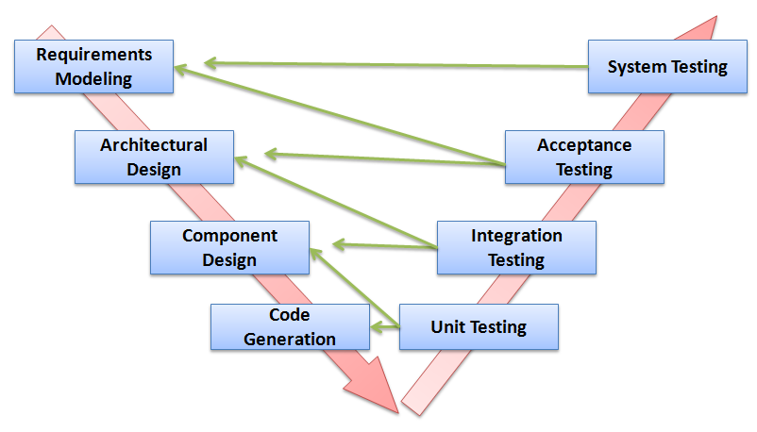
V-Model

Slide 10
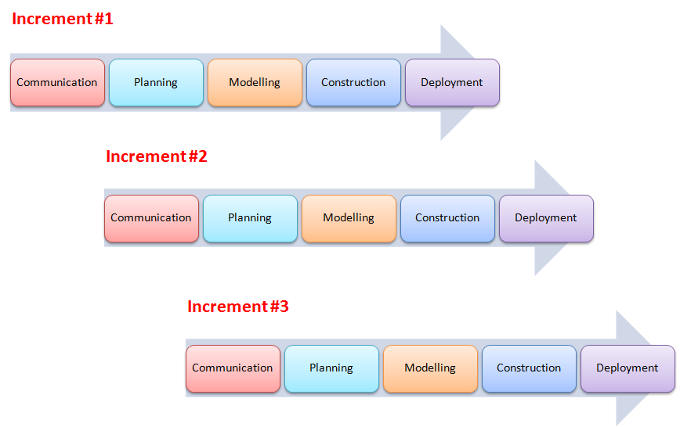
Incremental Model
(Diagram)

Slide 11
The Incremental Model
Rather than deliver the system as a single delivery, the development and delivery is broken down into increments with each increment delivering part of the required functionality.
First Increment is often core product
  Includes basic requirement
  Many supplementary features (known & unknown) remain undelivered
First Increment is used or evaluated
A plan of next increment is prepared
  Modifications of the first increment
  Additional features of the first increment
It is particularly useful when enough staffing is not available for the whole project
Increment can be planned to manage technical risks

Slide 12
The Incremental Model
User requirements are prioritised and the highest priority requirements are included in early increments.
Once the development of an increment is started, the requirements are frozen though requirements for later increments can continue to evolve.
Customer value can be delivered with each increment so system functionality is available earlier.
Early increments act as a prototype to help elicit requirements for later increments.
Lower risk of overall project failure.
The highest priority system services tend to receive the most testing.

Slide 13
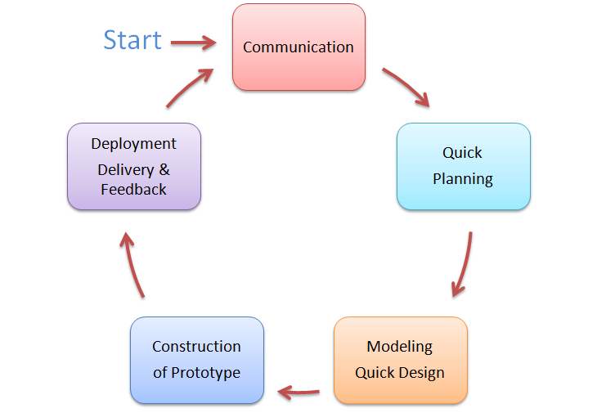
Prototyping Model
(Diagram)

Slide 14
Prototyping Model
Follows an evolutionary and iterative approach
Used when requirements are not well understood
Serves as a mechanism for identifying software requirements
Focuses on those aspects of the software that are visible to the customer/user
Feedback is used to refine the prototype

Slide 15
Prototyping Model
(Potential Problems)
The customer sees a "working version" of the software, wants to stop all development and then buy the prototype after a "few fixes" are made
Developers often make implementation compromises to get the software running quickly (e.g., language choice, user interface, operating system choice, inefficient algorithms)
Important Considerations:
  Define the rules up front on the final disposition of the prototype before it is built
  In most circumstances, plan to discard the prototype and engineer the actual production software with a goal toward quality

Slide 16
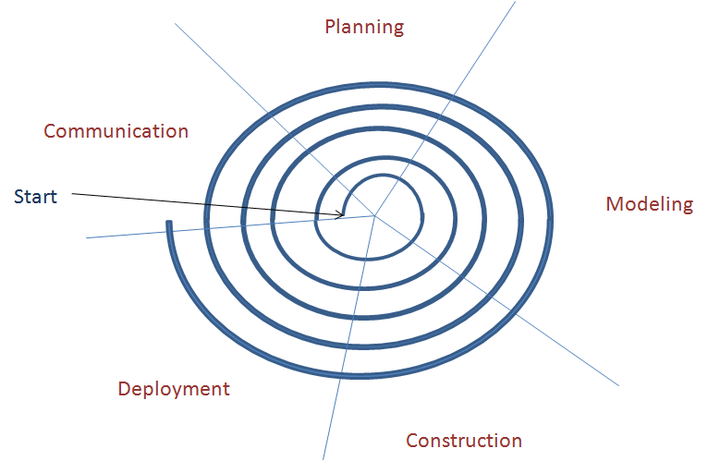
Spiral Model
(Diagram)

Slide 17
Spiral Model
Proposed by Dr. Barry Boehm in 1988 while working at TRW
Follows an evolutionary approach
Used when requirements are not well understood and risks are high
Inner spirals focus on identifying software requirements and project risks; may also incorporate prototyping
Outer spirals take on a classical waterfall approach after requirements have been defined, but permit iterative growth of the software
Operates as a risk-driven model…a go/no-go decision occurs after each complete spiral in order to react to risk determinations
Requires considerable expertise in risk assessment
Serves as a realistic model for large-scale software development

Slide 18
General Weaknesses of Evolutionary Process Models
As per Nogueira et al,
  Evolutionary models pose a problem to project planning because of the uncertain number of iterations required to construct the product
  Evolutionary software processes do not establish the maximum speed of the evolution
    If too fast, the process will fall into chaos
    If too slow, productivity could be affected
  Software processes should focus first on flexibility and extensibility, and second on high quality
    We should prioritize the speed of the development over zero defects
    Extending the development in order to reach higher quality could result in late delivery

Slide 19
Thank You…

Slide 20
Credits
Software Engineering 7/ed by Roger Pressman – Reference

